Slide 1
Introduction to Statistics

Slide 2
Content
Measures of Central Tendency
Measures of Location
Measures of Dispersion
Measures of Symmetry
Measures of Peakedness

Slide 3
What is a statistics?
Statistics is the science of collecting, organizing, and interpreting numerical facts, which we call data. Data are numerical facts.
For example
We are bombarded by data in our everyday lives. The news mentions imported car sales, the latest violence and number of deaths of people in some countries, the popularity of some political party, and the average high temperature for today’s date. All sides in public debates about economics, education, and social policy argue from data.
A knowledge of statistics helps separate sense from nonsense and to deal with enormous data that us around us.

Slide 4
Describing a population
Characteristics of a population, e.g. the population mean μ and the population standard deviation σ are never known exactly
Sample characteristics, e.g. and are estimates of population characteristics μ and σ
A sample characteristic, e.g. ,is called a statistic and a population characteristic, e.g. μ is called a parameter

Slide 5
Statistical Inference
Population
(parameters, e.g., μ and σ)
select sample at random
Sample
collect data from individuals in sample
Data
Analyse data (e.g. estimate ) to make inferences

Slide 6
Statistical estimation
Every member of the
population has the
same chance of being
selected in the sample
Population
Parameters
Random sample
estimation
Statistics

Slide 7
Types of statistical analysis: Descriptive and Inferential statistics
Descriptive statistics
Summarizes the data in terms of center point, dispersion, and distribution.
Central tendency: Locating the centre point (mean, mode, median)
Dispersion: The spread in terms of smallest values to the largest (variability).
Distribution: the spread of the data in terms of symmetry, skewed, peaked, flat, etc.
Inferential statistics
Estimate population parameters.
Compare significant difference between two or more population.
Tests for relationship between variables to make prediction.

Slide 8
Descriptive statistics
Descriptive statistics can be used to summarize and quantitatively describing the main features of a collection of information. Descriptive statistics aim to summarize the sample rather than use the data to learn about the population.
Descriptive statistics is commonly used to describe a data set about:
Measures of central tendency: Mean, Mode, Median
Measures of variability (dispersion): Standard deviation, Variance, Coefficient of variation, Range etc.
Measures of shapes of distribution: Skewness (Positively skewed and Negatively skewed) and Kutosis (Leptokurtic and platykurtic distribution)

Slide 9
Inferential statistics
Inferential statistics can be used to prove or disprove theories, determine associations between variables, and determine if findings are significant and whether or not we can generalize from our sample to the entire population.
Some of the examples of inferential statistical tools are as follows:
T-tests/ANOVA
Correlation
Regression
Chi-square and etc.

Slide 10
Descriptive Statistics: Frequency
A fancy name for a Table
Data set | 1, 2, 4, 5, 5, 6, 2, 2, 4, 3, 3, 3,
 | 6, 1, 3, 1, 3, 2, 5, 2, 1, 2, 3, 4
No of siblings | Frequency (count)
1 | 4
2 | 7
3 | 6
4 | 3
5 | 3
6 | 2

Slide 11
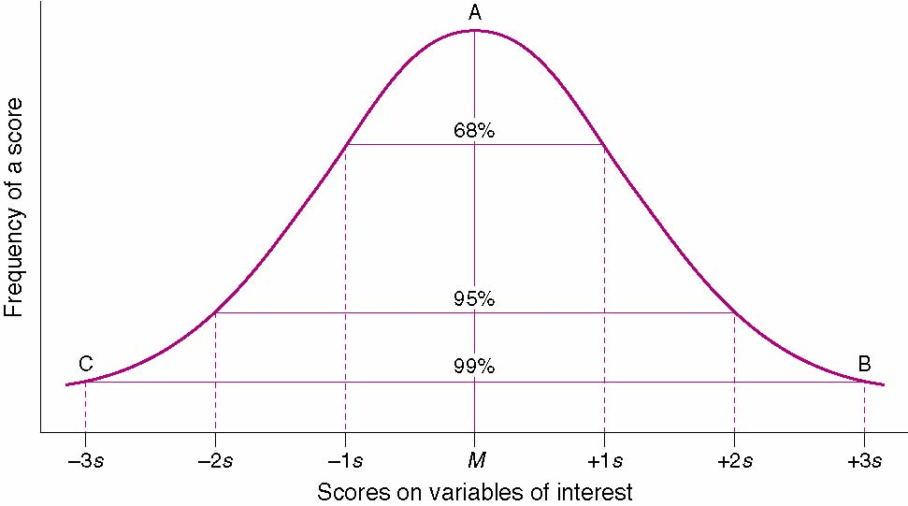
Descriptive Statistics: Central Tendency
Measures of central tendency describe the average or common score of a group of scores
Common measures of central tendency include the mean, median, and mode

Slide 12
Mean
The mean is the arithmetic average of the scores
The calculation of the mean considers both the number of scores and their value
The formula for the mean of the variable X is:

Slide 13
Mean
Six men with high serum cholesterol participated in a study to examine the effects of diet on cholesterol
At the beginning of the study, their serum cholesterol levels (mg/dL) were:
366, 327, 274, 292, 274, 230
Determine the mean:

Slide 14
Mean

Slide 15
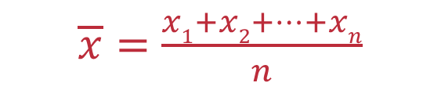
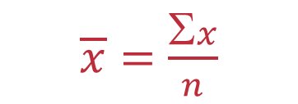
Mean
The mean (arithmetic mean or average) of a set of data is found by adding up all the items and then dividing by the sum of the number of items.
The mean of a sample is denoted by (read “x bar”).
The mean of a complete population is denoted by (the lower case Greek letter mu).
The mean of n data items x₁, x₂,…, x_{n}, is given by the formula
or

Slide 16
Example:
Ten students were polled as to the number of siblings in their individual families.
The raw data in the following set: {3, 2, 2, 1, 3, 6, 3, 3, 4, 2}.
Find the mean number of siblings for the ten students.
siblings

Slide 17
Weighted Mean
The weighted mean of n numbers x₁, x₂,…, x_{n}, that are weighted by the respective factors f₁, f₂,…, f_{n} is given by the formula:

Slide 18
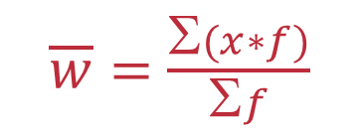
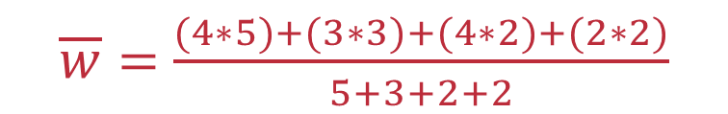
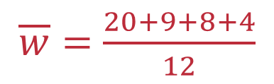
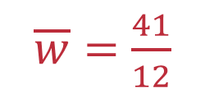

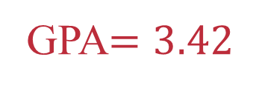
Weighted Mean
Listed below are the grades of a students semester courses. Calculate the Grade Point Average (GPA).
Course | Grade | Points (x) | Credits (f) | x * f
Math | A | 4 | 5
History | B | 3 | 3
Health | A | 4 | 2
Art | C | 2 | 2
20
9
8
4

Slide 19
Calculating the Mean Using SPSS
Analyze -> Descriptive Statistics -> Frequencies command may be used to determine the mean (you will need to select the “Statistics…” button to choose the “Mean”

Slide 20
Median
Another measure of central tendency, is the median.
This measure divides a group of numbers into two parts, with half the numbers below the median and half above it.
The median is not as sensitive to extreme values as the mean.
To find the median of a group of items:
1. Rank the items.
2. If the number of items is odd, the median is the middle item in the list.
3. If the number of items is even, the median is the mean of the two middle numbers.

Slide 21
Contd..
The position of the median (Mdn) can be calculated as follows:

Slide 22
Contd..
Example: Calculate the median for the following measurements for height:
71”, 73”, 74”, 75”, 72”

Slide 23
Contd…
Step One: Place the scores in order from lowest to highest.
71”, 72”, 73”, 74”, 75”
Step Two: Calculate the position of the median using the following formula:
Step Three: Determine the value of the median by counting from either the highest or the lowest score until the desired score is reached (in this case the 3rd score).

Slide 24
Contd..
Suppose that in our previous distribution we had a sixth score as follows:
71”, 72”, 73”, 74”, 74”, 75”
What are the position and value of the median?
Consider the following example: Nine people each perform 40 sit-ups, and one does 1,000
The median score for the group is 40, and the mean (arithmetic average) is 136
The median would still be 40 even if the highest score were 2,000 instead of 40

Slide 25
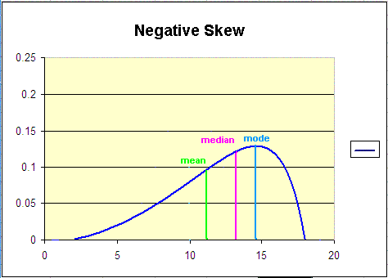
The Median is Unaffected by Extreme Scores

Slide 26
Example:
Contd…
Ten students in a math class were polled as to the number of siblings in their individual families and the results were:
3, 2, 2, 1, 1, 6, 3, 3, 4, 2.
Find the median number of siblings for the ten students.
Position of the median: 10/2
= 5
Between the 5th and 6th values
Data in order: 1, 1, 2, 2, 2, 3, 3, 3, 4, 6
Median
= (2+3)/2
= 2.5
siblings

Slide 27
Contd…
Example:
Nine students in a math class were polled as to the number of siblings in their individual families and the results were:
3, 2, 2, 1, 6, 3, 3, 4, 2.
Find the median number of siblings for the ten students.
Position of the median: 9/2
= 4.5
The 5th value
In order: 1, 2, 2, 2, 3, 3, 3, 4, 6
Median = 3
siblings

Slide 28
Median in a Frequency Distribution
Contd…
Example:
Find the median for the distribution.
Value (x) | 1 | 2 | 3 | 4 | 5
Frequency (f) | 4 | 3 | 2 | 6 | 8
Position of the median is the sum of the frequencies divided by 2.
Σ (f)
23
Position of the median =
=
=
11.5
= 12th term
2
2
Add the frequencies from either side until the sum is 12.
The 12th term is the median and its value is 4.

Slide 29
Mode
The mode is the most frequently occurring score
Which of the following scores is the mode?
3, 7, 3, 9, 9, 3, 5, 1, 8, 5
Similarly, for another data set (2, 4, 9, 6, 4, 6, 6, 2, 8, 2), there are two modes; What are they?
What is the mode for 7, 7, 6, 6, 5, 5, 4 and 4

Slide 30
Contd…
The mode of a data set is the value that occurs the most often.
If a distribution has two modes, then it is called bimodal.
In a large distribution, this term is commonly applied even when the two modes do not have exactly the same frequency
Example:
Ten students in a math class were polled as to the number of siblings in their individual families and the results were: 3, 2, 2, 1, 3, 6, 3, 3, 4, 2. Find the mode for the number of siblings.
3, 2, 2, 1, 3, 6, 3, 3, 4, 2
The mode for the number of siblings is 3.

Slide 31
Mode in a Frequency Distribution
Contd..
Example:
Find the mode for the distribution.
Value (x) | 1 | 2 | 3 | 4 | 5
Frequency (f) | 4 | 3 | 2 | 6 | 8
The mode in a frequency distribution is the value that has the largest frequency.
The mode for this frequency distribution is 5 as it occurs eight times.

Slide 32
Central Tendency-other measures of location
Other measures of location include the percentiles and quartiles
Percentile divides the series of data into 100 parts
The median of these 100 parts is the 2nd quartile (Q2 or 50th percentile)
Dividing the median or Q2 further by 2 will provide the 1st quartile (Q1 or 25th percentile) in the lower half range and adding Q1 & Q2 will provide the 3rd quartile (Q3 or 75th percentile) in the upper half range

Slide 33
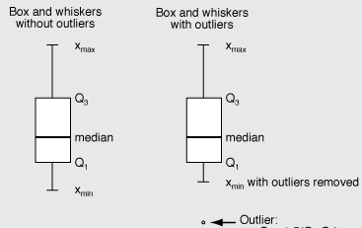
Central Tendency – contd…
Box whisker plot is useful in presenting the quartiles and percentiles graphically
Difference between Q3 and Q1 is called the interquartile range
Outlier is calculated by equation:
Q3 + 1.5 (Q3-Q1) and/or
Q1 – 1.5 (Q3-Q1)
Box plot, also referred as 5-number summary, tells us about the median (Q2), Q1, Q3, minimum and maximum values
Exercise 1:
Calculate (manual) the percentiles and quartiles for: 1, 2, 3, 4, 5, 6, 7, 8, 9, 10 and 20

Slide 34
Statistics – Central Tendency
Exercise 2:
Using SPSS
for the following numbers:
1, 2, 3, 4, 5, 6, 7, 8, 9, 10 and 20
1 Calculate the:
Percentiles
Quartiles
Mean
Median
Mode
Draw a box ‘whisker plot’
Check of any ‘outliers’

Slide 35
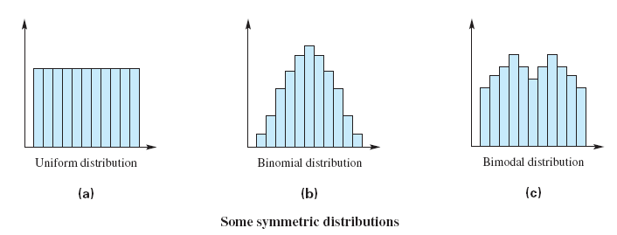
Symmetry in Data Sets
The analysis of a data set often depends on whether the distribution is symmetric or non-symmetric.
Symmetric distribution: the pattern of frequencies from a central point is the same (or nearly so) from the left and right.

Slide 36
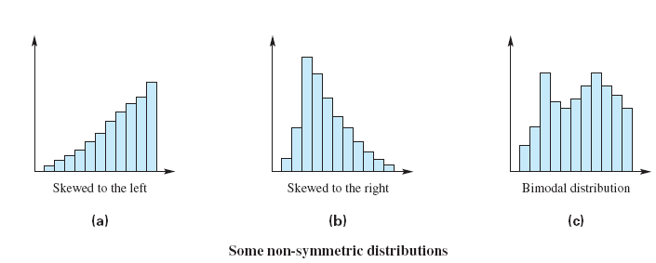
Symmetry in Data Sets
Non-symmetric distribution: the patterns from a central point from the left and right are different.
Skewed to the left: a tail extends out to the left.
Skewed to the right: a tail extends out to the right.

Slide 37
Calculating the Mode Using SPSS
Analyze -> Descriptive Statistics -> Frequencies command may be used to calculate the mode (you will need to select the “Statistics…” button to choose the mode, etc
Note differences in the SPSS output when the distribution is unimodal, multimodal, or when there is no mode

Slide 38
Measures of Variability (dispersion)
Measures of variability describe the extent of similarity or difference in a set of scores
These measures include the range, standard deviation, and variance

Slide 39
Standard Deviation (SD)
Standard Deviation – a measure of the variability, or spread, of a set of scores around the mean
Intuitively, the sum of the differences between each score and the mean (known as deviation scores) is a good approach to measure variability around the mean

Slide 40
Contd…
Symbolically, SD can be written as:
Let’s use the scores 1, 2, 6, 6, and 15, where

Slide 41
Contd…
Now let’s calculate the sum of the deviation scores:
= (1-6) + (2-6) + (6-6) + (6-6) + (15-6)
= (-5) + (-4) + (0) + (0) + (9)
= = -9 + 9 = 0

Slide 42
Contd…
We can avoid this problem (deviation scores sum to 0) by squaring each deviation score before summing them
This would be written symbolically as

Slide 43
Contd…
Substituting the X scores again,
= (1-6)² + (2-6)² + (6-6)² + (6-6)² + (15-6)²
= (-5)² + (-4)² + (0)² + (0)² + (9)²
= 25 + 16 + 0 + 0 + 81
= 122

Slide 44
Contd…
Then divide this value by n-1 (degrees of freedom) to arrive at the mean squared deviation
122/4 = 30.5
Then take the square root of this value to bring the units back to the raw score units

Slide 45
Example 1: calculation of variance and standard deviation on strength scores.
Subj
Score (x)
Deviation
(x)²
1
216
22.7
515.29
2
144
-49.3
2430.49
3
183
-10.3
106.09
4
138
-55.3
3058.09
5
212
18.7
349.69
6
180
-13.3
176.89
7
200
6.7
44.89
8
264
70.7
4998.49
Standard Deviation (S²) = 1471.75
Variance (S) = 38.4
9
203
9.7
94.09
Σ=1740
Σ=0
Σ=11774.01

Slide 46
Calculating the Standard Deviation Using SPSS
Analyze -> Descriptive Statistics -> Frequencies command may be used to determine the standard deviation (you will need to select the “Statistics…” button to choose the “Std. deviation”

Slide 47
Variance
The variance is the square of the standard deviation (S²)
It is used most commonly with more advanced statistical procedures such as analysis of variance (ANOVA), regression and the determination of the reliability of a test

Slide 48
Contd…
The variance is also known as the mean square (MS)

Slide 49
Range
The range is equal to the high score minus the low score in a distribution
It is considered an unstable measure of variability, and can change drastically if extreme scores are introduced to the distribution

Slide 50
Contd….
As a result of gas analysis in a respirometer, an investigator obtains the following four readings of oxygen percentages:
14.9, 10.8, 12.3, and 23.3
What is the range?

Slide 51
Calculating the Range Using SPSS
Analyze -> Descriptive Statistics -> Frequencies command may be used to calculate the range (you will need to select the “Statistics…” button to choose “Minimum,” “Maximum,” and “Range”

Slide 52
[Measures of Symmetry: (Skewness) and Peakedness (Kurtosis)] Skewness
The term skewness refers to the lack of symmetry. The lack of symmetry in a distribution is always determined with reference to a normal or Gaussian distribution.
Note that a normal distribution is always symmetrical.
The skewness may be either positive or negative. When the skewness of a distribution is positive (negative), the distribution is called a positively (negatively) skewed distribution.

Slide 53
Contd…
Skewness
Symmetric distribution
Positively skewed distribution
Negatively skewed distribution

Slide 54
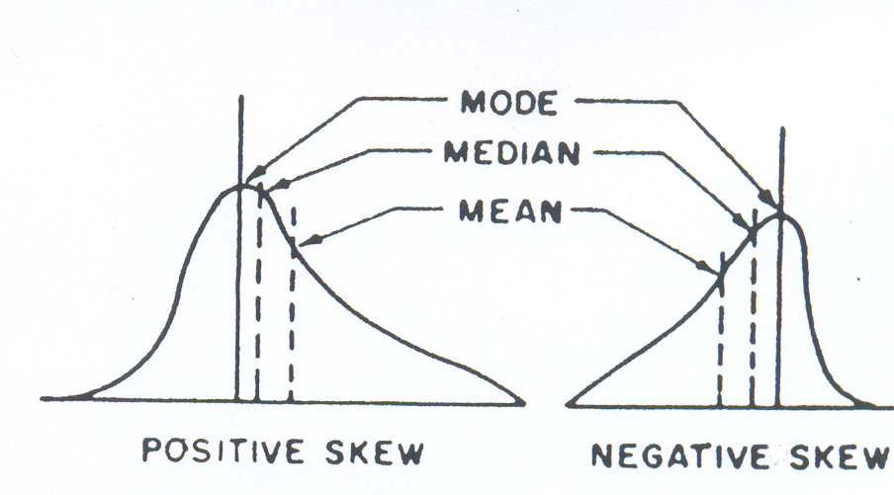
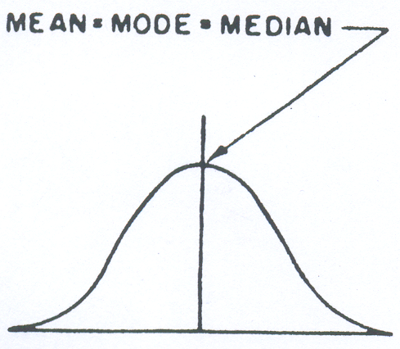
Measures of Skewness
If Mean > Mode, the skewness is positive.
If Mean < Mode, the skewness is negative.
If Mean = Mode, the skewness is zero.
Symmetric

Slide 55
Contd….
Many distribution are not symmetrical and they may be tail off to right or to the left and as such said to be skewed.
One measure of absolute skewness is difference between mean and mode. A measure of such would not be true meaningful because it depends of the units of measurement.
The simplest measure of skewness is the Pearson’s coefficient of skewness:

Slide 56
Exercise-1: Find coefficient of Skewness using Pearson’s formula
Income of daily Labour | Frequency (f) | (x)
40-50 | 3 | 45
50-60 | 5 | 55
60-70 | 10 | 65
70-80 | 8 | 75
80-90 | 4 | 85
90-100 | 4 | 95
100-110 | 1 | 105
Sum | N=35

Slide 57
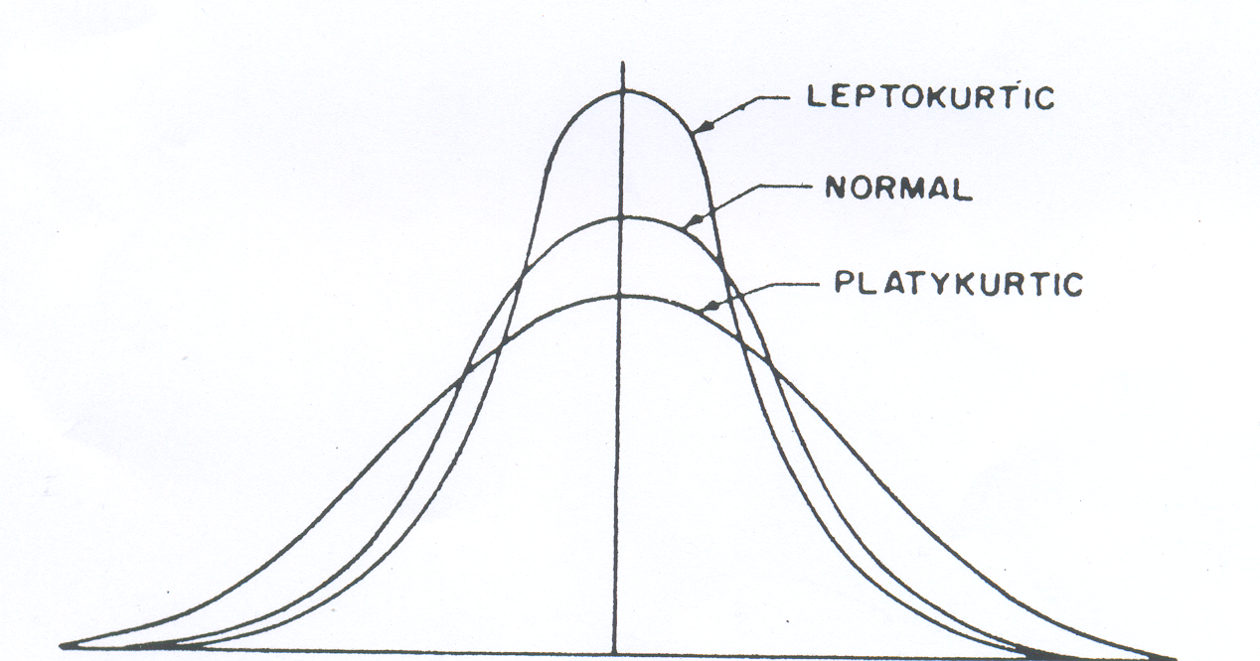
Measures of Peakedness
Kurtosis:
is the degree of peakedness of a distribution, usually taken in relation to a normal distribution.
Leptokurtic
Platykurtic
Mesokurtic/Normal

Slide 58
Kurtosis
A curve having relatively higher peak than the normal curve, is known as Leptokurtic.
On the other hand, if the curve is more flat-topped than the normal curve, it is called Platykurtic.
A normal curve itself is called Mesokurtic, which is neither too peaked nor too flat-topped.

Slide 59
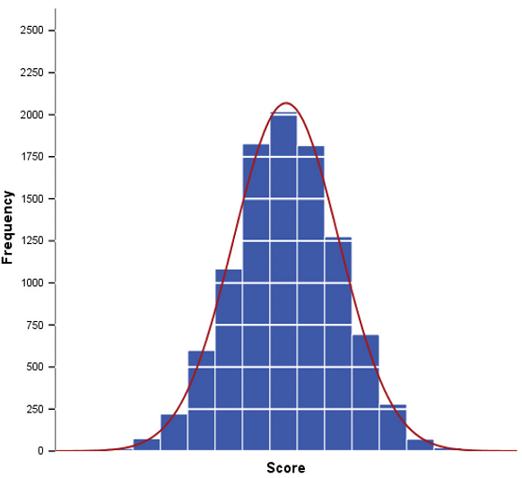
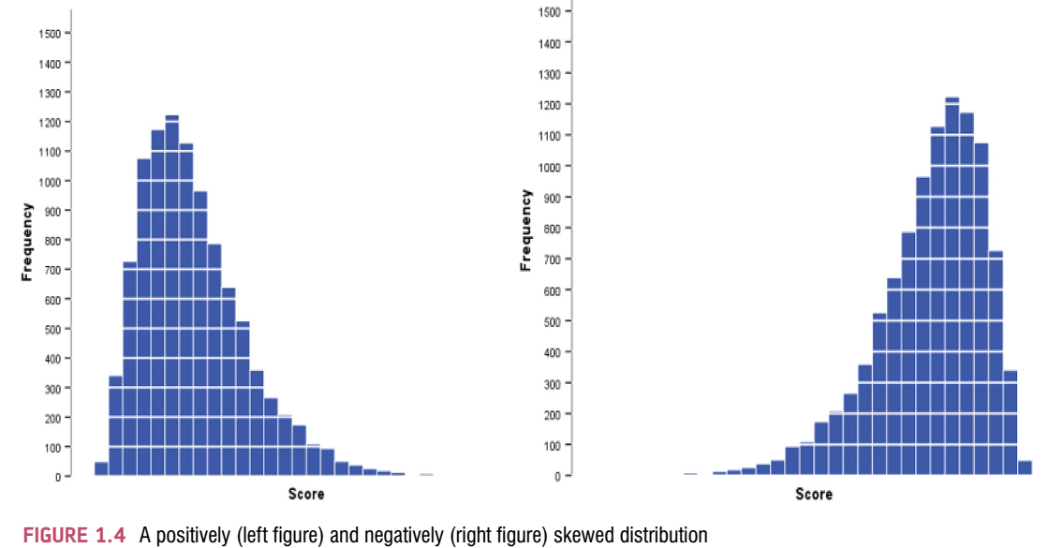

Slide 60
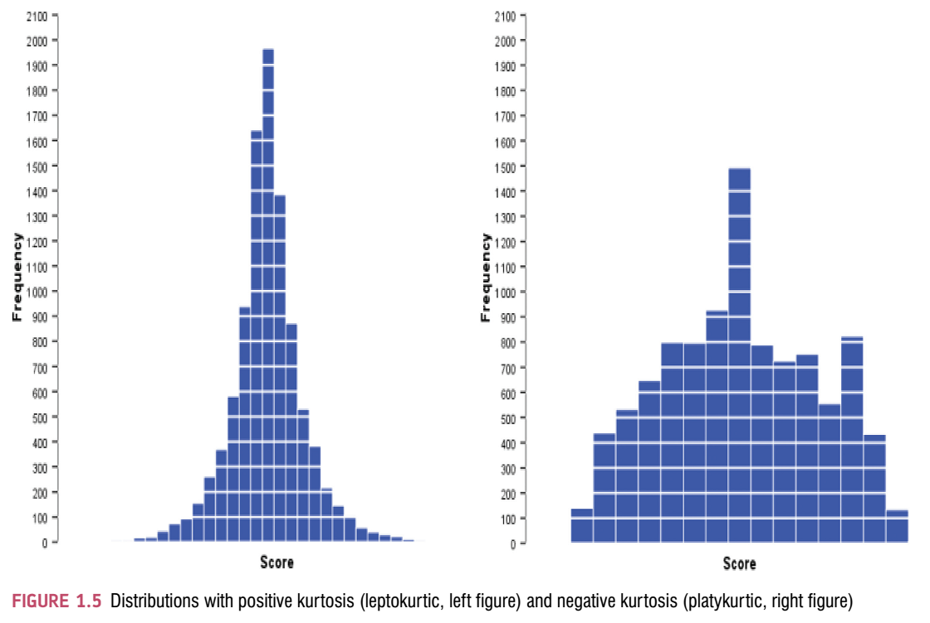

Slide 61
